Slide 1
Smart Parking System
Submitted By- Submitted To-
Amit Mohan Rajput(2100290140024) Ms. Shweta Singh
Dhaval Krishna(2100290140059) Assistant Professor
Nikhil Agarwal(2100290140095)

Slide 2
INTRODUCTION
Smart parking system using IoT has sensors added into an interconnected system to determine parking space or level and provide real-time feedback. It is accomplished by using cameras, counters on the doors or gates of parking lots, sensors embedded in the paved area of individual parking lots, among other locations, depending on the deployment.
Each parking space has an IoT gadget, which includes sensors and microcontrollers. The user gets real-time updates on the availability of all parking spaces and, therefore, an option to choose the best one. This solution alone initiates a chain-reaction of benefits, from lesser traffic congestion to reduced fuel efficiency, in urban areas where parking is often painstaking.
A simple and easy task such as parking is thought as a tedious and time-consuming process due to mismanagement of parking system. Current parking systems involve huge manpower for management and requires user to search for parking space floor by floor. Such conventional systems utilize more power, along with user’s valuable time. This paper presents a Smart Parking Energy Management solution for a structured environment such as a multi-storied office parking area.

Slide 3
Area of Focus
Security and safety: Smart parking systems can incorporate security features such as cameras and emergency call boxes to enhance safety and deter criminal activity.
Sustainability: Smart parking systems can incorporate features such as electric vehicle charging stations, bike racks, and car-sharing services to promote sustainable transportation options.

Slide 4
Background
1. A Social IoT-based platform for the deployment of a smart parking solution
Simone Porcu , Luigi Atzori , Roberto Girau
Magnetometer sensors and Bluetooth beacons. The proposed system addresses the issues of scalability, interoperability, low energy consumption, and timely prediction of parking spot availability. The system uses magnetometer sensors and concentrators to collect data on parking spot occupancy, and a control dashboard provides data analytics and management of the monitored parking areas. The system also includes a smart payment service that allows users to pay for parking services automatically through Bluetooth beacons. Experiments conducted on a test-bed demonstrate the system's ability to detect the presence of a vehicle and trigger the payment procedure. The use of virtual entities in the SIoT environment enables interoperability among different types of IoT devices used by separate solutions deployed in adjacent areas, thereby addressing the heterogeneity of IoT devices. Overall, the proposed solution provides an efficient and effective smart parking system for on-street parking areas.

Slide 5
Background (cont..)
2. Smart parking in IoT-enabled cities: A survey
Fadi Al-Turjmana, Arman Malekloob
This paper discusses the importance of smart parking systems in addressing the issue of parking scarcity in overcrowded cities. The authors classify smart parking systems based on soft and hard design factors and provide an overview of enabling technologies and sensors commonly used in the literature. They emphasize the importance of data reliability, security, privacy, and other critical design factors in such systems. The paper also discusses emerging parking trends in the ecosystem, focusing on data interoperability and exchange. The authors outline open research issues in the current state of smart parking systems and recommend a conceptual hybrid-parking model. The paper presents software aspects of smart parking, including parking prediction, path optimization, and parking assignment. Tables are generated to compare several key factors of the main elements in a smart parking system, including sensors and communication modules. The paper concludes by suggesting cloud-based hybrid models to solve key issues in smart parking applications and proposing future research on interoperability and drones.

Slide 6
Background (cont…)
3. Smart Parking—A Wireless Sensor Networks Application Using IoT
Suman Balhwan, Deepali Gupta, Sonal and S. R. N. Reddy
This paper discusses the design and development of a wireless sensor node for a smart parking system using IoT. The system uses various sensors to detect parking slot availability, and the information is uploaded to the cloud, which can be accessed by users using an Android app. The sensor node is connected with other sensor nodes to create a heterogeneous wireless sensor network, with one node acting as the master node and the rest as slave nodes. The QoS parameters are observed and calculated to determine the efficiency of the network

Slide 7
Challenges
Cost: Integrating security and sustainability features into a smart parking system can be costly, especially if it involves retrofitting existing infrastructure. This can be a challenge for municipalities and parking operators that have limited budgets.
Maintenance: Sustainability features such as electric vehicle charging stations require regular maintenance to ensure they are functioning properly. This can be a challenge for parking operators who may not have the resources or expertise to maintain these systems.
Integration with existing infrastructure: Integrating security and sustainability features into an existing parking system can be a challenge, especially if the system is outdated or incompatible with new technology.

Slide 8
Challenges (cont..)
User behavior: Encouraging users to adopt sustainable transportation options such as electric vehicles or bike-sharing can be a challenge, as it requires a shift in user behavior and may not be practical for all users.
Weather conditions: Sustainability features such as solar panels may not perform as well in areas with low sunlight or frequent inclement weather, making them less reliable as a power source.

Slide 9
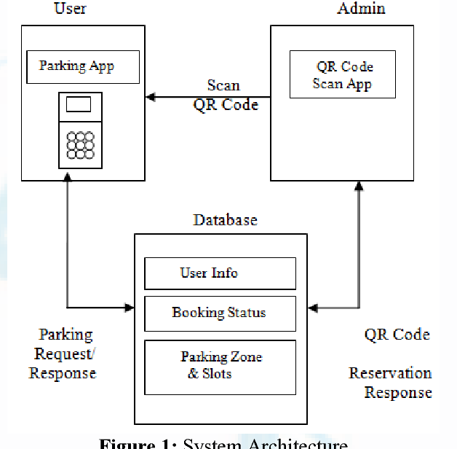
Phase Diagram

Slide 10
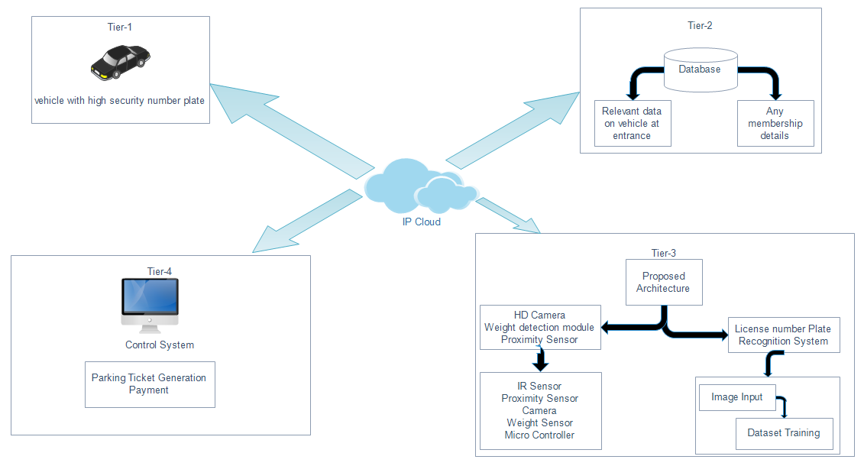
Flowchart/Scenario

Slide 11
Technical Implications
Hardware Software
Coded with embedded C Language
Number | Description
1 | Node MCU
2 | IR Sensors
3 | Servo Motors
4 | LED Lights
5 | LED Display
Number | Description | Type
1 | Arduino IDE | Windows
2 | Cayenne | JavaScript

Slide 12
Thank You

